Slide 1
CMM levels and KPAs at each level.
BY MUGDHA SAWALAPURKAR
21101A0004

Slide 2
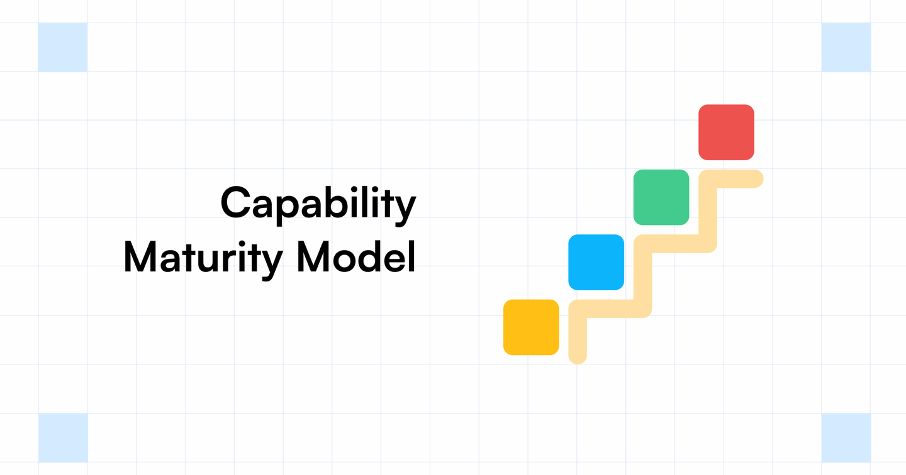
Introduction
Capability Maturity Model, often abbreviated as CMM, is a framework designed to evaluate and improve the processes within a software development organization.
Developed by Software Engineering Institute(SEI) at Carnegie Mellon University in 1987.
99%
32M
240%
Customer satisfaction
Active users
Company growth

Slide 3

Key Process Areas (KPAs)
The Key Process Areas (KPAs) are the areas that organizations should focus on to optimize their processes. They include requirements management, project planning, project monitoring and control, process and product quality assurance, and configuration management.

Slide 4
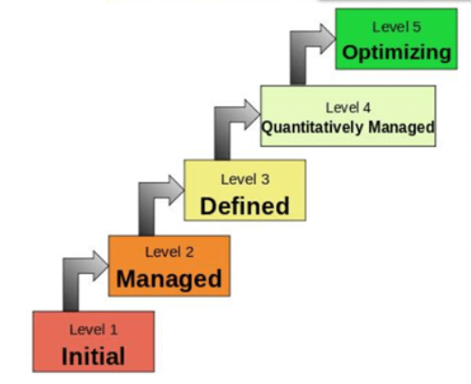
5 levels of CMM

Slide 5


CMM Level 1: Initial
At CMM Level 1, processes are ad hoc and chaotic. There is no formal process in place, and success depends on individual effort. Organizations at this level are reactive and struggle to deliver projects on time and within budget.

Slide 6
Level 1: Initial KPA
At the initial level, there are no predefined KPAs because processes are generally ad hoc, unpredictable, and poorly controlled. The focus here is often on completing projects rather than establishing consistent processes.

Slide 7



CMM Level 2: Managed.
At CMM Level 2, processes are repeatable and documented. Organizations at this level have basic project management practices in place and can deliver projects on time and within budget. However, there is still room for improvement.

Slide 8
Level 2: Managed KPA
Requirements Management
Project Planning
Project Monitoring and Control
Subcontract Management
Quality Assurance
Configuration Management

Slide 9

CMM Level 3: Defined
At CMM Level 3, processes are well-defined and standardized. Organizations at this level have a formal process in place and can consistently deliver quality products and services. The focus is on continuous improvement.

Slide 10
Level 3: Defined KPA
Organization Process Focus
Organization Process Definition
Training Program
Integrated Project Management
Risk Management
Integrated Teaming
Subcontract Management

Slide 11


CMM Level 4: Quantitatively Managed
At CMM Level 4, processes are measured and controlled. Organizations at this level use data to make informed decisions and can predict the outcome of their projects. The focus is on quantitative management.

Slide 12
Level 4: Quantitatively Managed KPA
Quantitative Process Management
Organizational Process Performance
Quantitative Management

Slide 13

CMM Level 5: Optimizing
At CMM Level 5, processes are continuously improved and optimized. Organizations at this level are proactive and use innovative approaches to improve their processes. The focus is on optimizing performance.

Slide 14
Level 5: Optimizing KPA
Organizational Innovation and Deployment
Causal Analysis and Resolution
Organizational Performance Management

Slide 15
Conclusion:
The Capability Maturity Model (CMM) provides a framework for organizations to optimize their processes. By focusing on the Key Process Areas (KPAs), organizations can improve their processes and deliver quality products and services.

